Slide 1
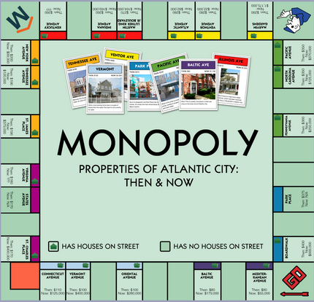
ESE224 Project
Monopoly

Slide 2
Basic rules/features
4 players with $10,000 take turns to play
Player 1 <- controlled by the user
Player 1-3 <- computer
Each player rolls a die and moves to the destination city.

Slide 3
Basic rules/features
Destination city owned by other players?
Yes
Pay the owner 1/5 of the price of the city
No
Buy the city
Don’t buy the city
Computers buy the city for 50% of chance

Slide 4
Basic rules/features
Is the Destination a special location (good or bad city)?
Yes
Good
Play mini card game
Bad
Lose $500
No
Do nothing

Slide 5
Card Game
The player randomly draws 2 cards from a deck
Do they cards have the same color
yes
The player gains [$100*(card1 number + card2 number)]
J = 11, Q = 12, K = 13, A = 14
no
Nothing happens

Slide 6
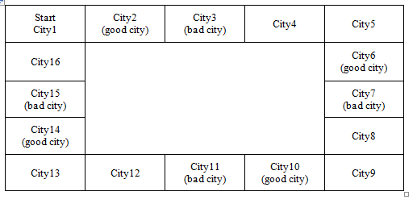
Map

Slide 7
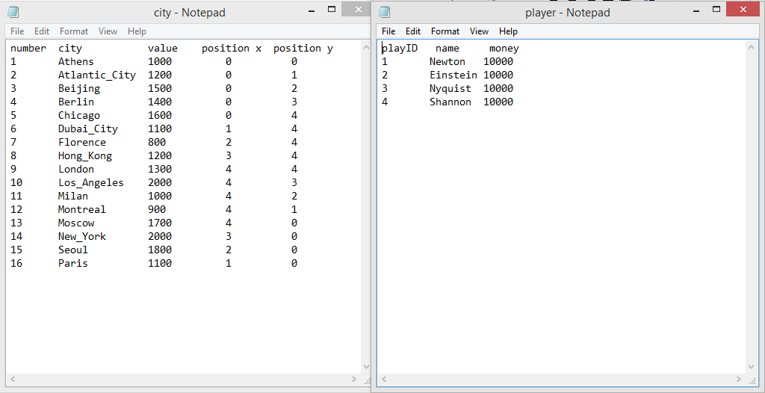
Implementation (txt files)

Slide 8
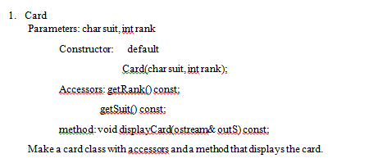
Implementation (header files)

Slide 9
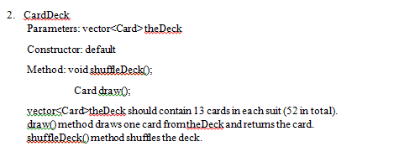
Implementation (header files)

Slide 10
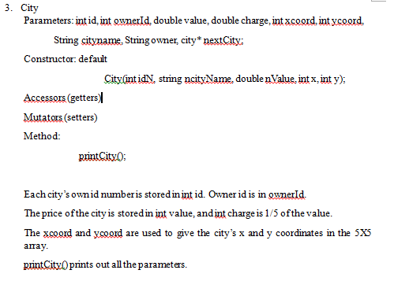
Implementation (header files)

Slide 11
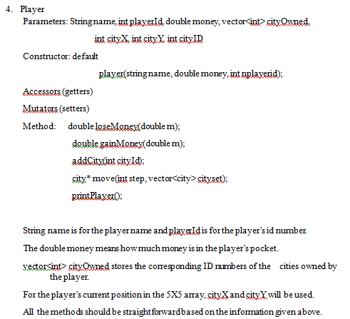
Implementation (header files)

Slide 12
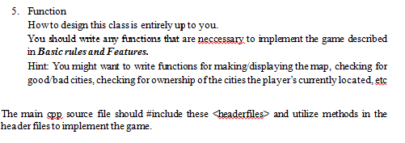
Implementation (header files + main)

Slide 13
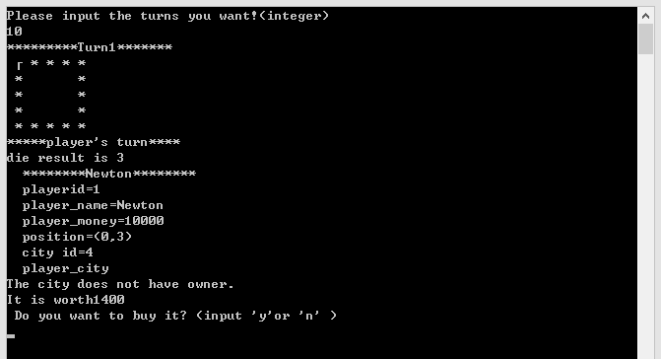
Expected Output

Slide 14
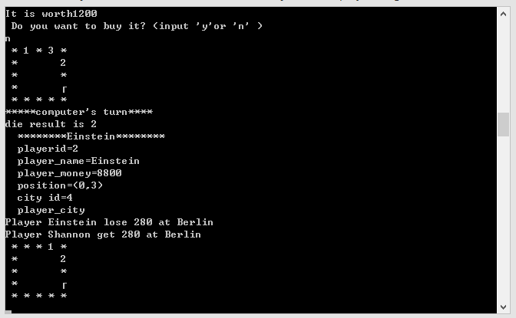
Expected Output

Slide 15
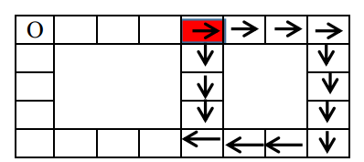
Extra point

Slide 16
Extra point
Read the information from extra.txt
Build the new map using a inheritance class.
Use the STL library to print out the path of the player from the end to the start point.

Slide 17
FAQ
If the player played the card game at a city and could the player buy this city?
The player can also buy the city after or before the card game.

Slide 18
FAQ
If a player’s money goes to negative, is the player able to buy a new city?
The player is not able to buy a city if he have negative money in his pocket.

Slide 19
FAQ
If you already own a 'bad city' and land on it, do you still lose $500?
Yes, you still need to pay for 500 even you owned it.

Slide 20
FAQ
Why I met the error class type redefinition?
#ifndef CITY_H
#define CITY_H
your class city
#endif

Slide 21
FAQ
If another player already owns a 'good city' and you land on it, do you still get to play the mini game?
Yes, the mini game is not influenced by the owner of the city.

Slide 22
Questions?

